Slide 1
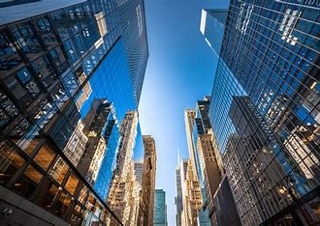

DEPI Real Estate

Slide 2
Team Member
Mohamed Mohsen
Mohamed Fo’ad
Abdelrahman Mohamed
Zyad Mohamed
Ahmed ElSayed

Slide 3
Table of contents
03
Data Cleaning
01
Data Collection
02
Explore Data
with Python
05
Data visualization
04
Explore Data
with SQL

Slide 4
01
Data Collection

Slide 5
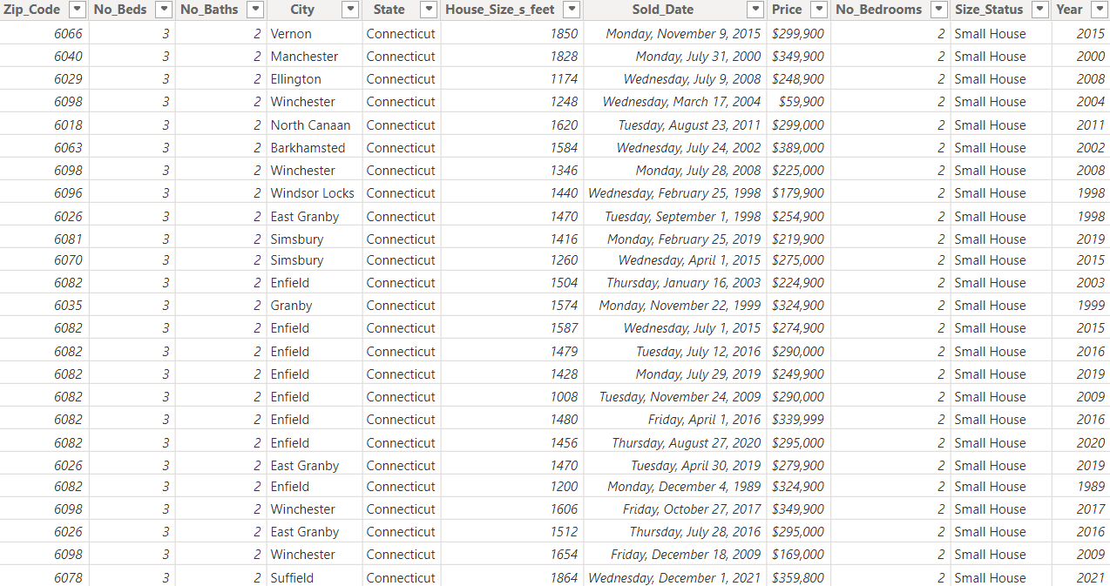

Slide 6
02
Explore Data
with Python

Slide 7
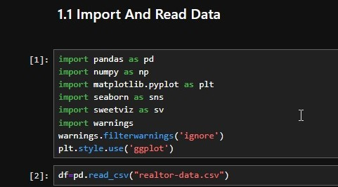
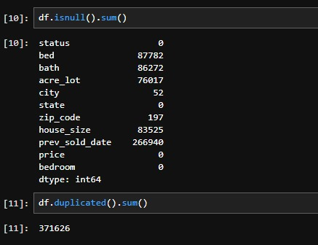
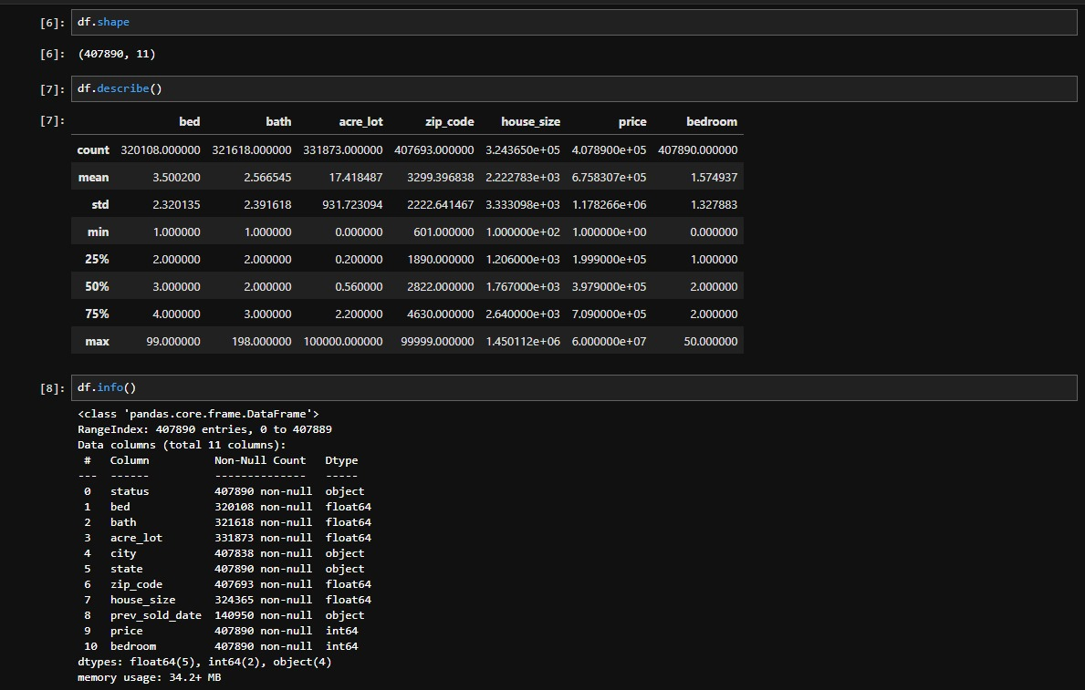

Slide 8
03
Data Cleaning

Slide 9
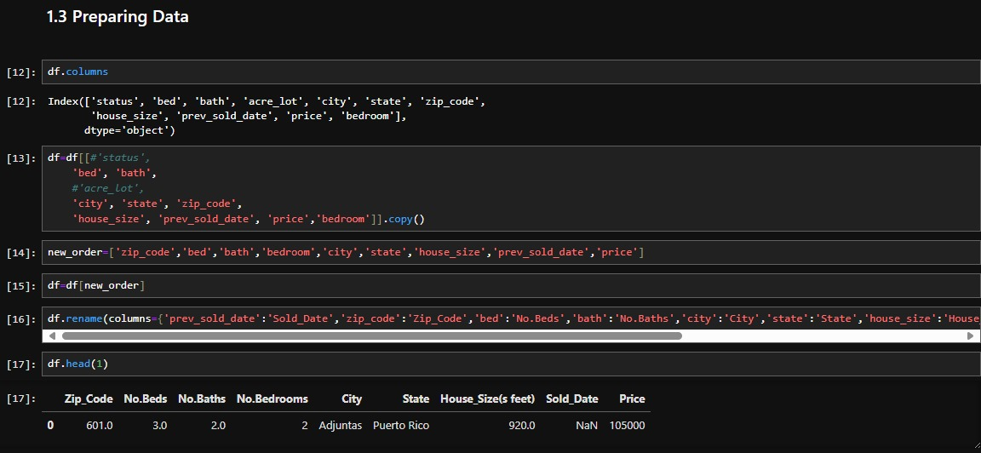

Slide 10
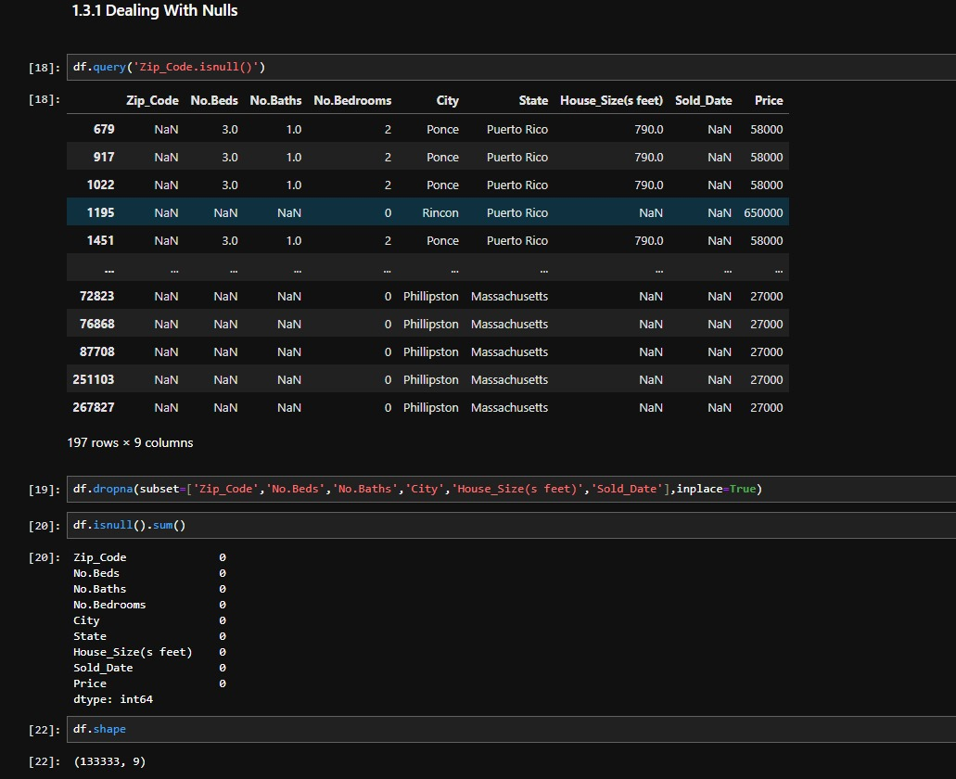

Slide 11
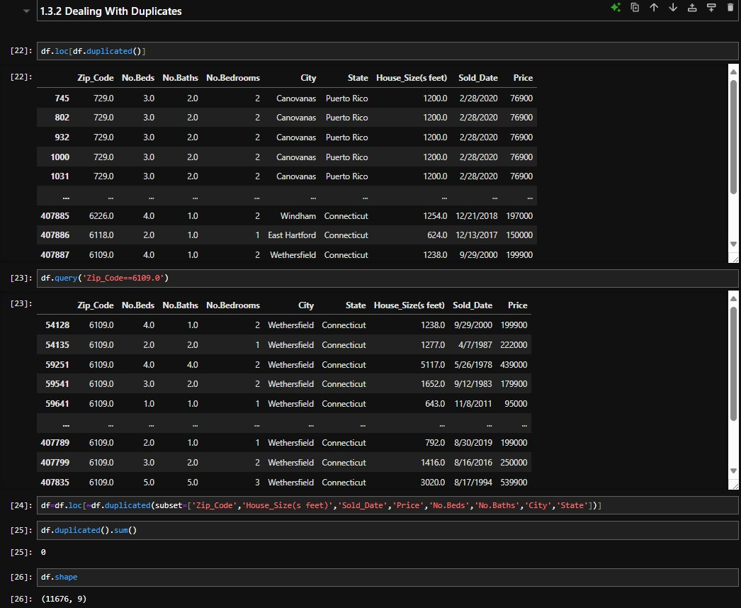

Slide 12
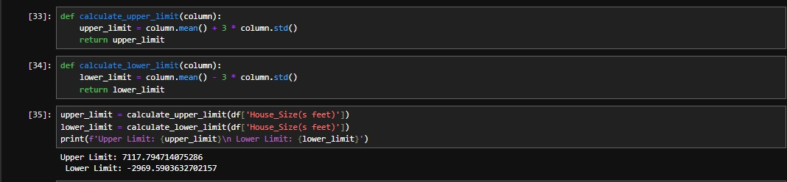
Explore Data after Cleaning

Slide 13
04
Explore Data
with SQL

Slide 14
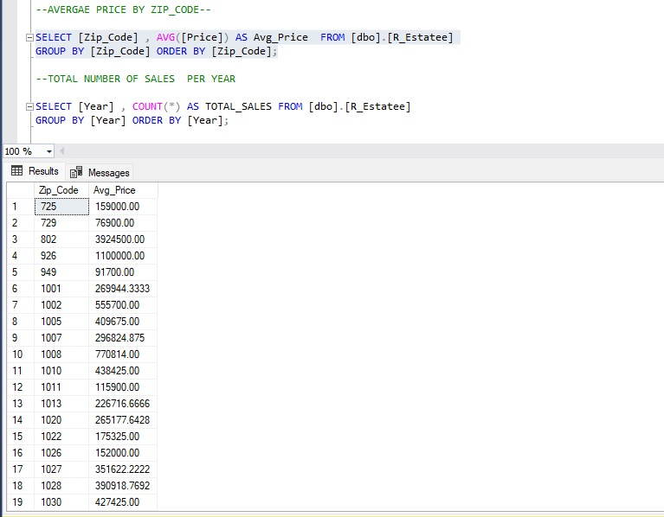
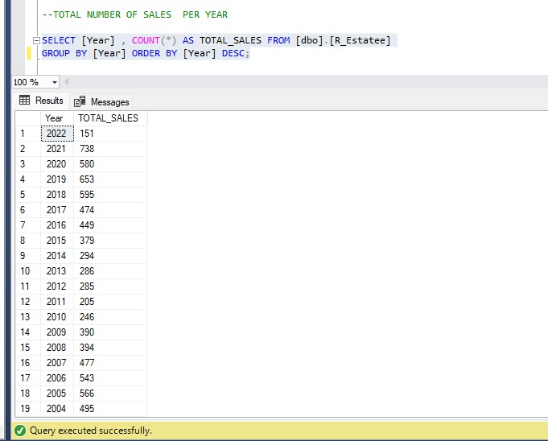

Slide 15
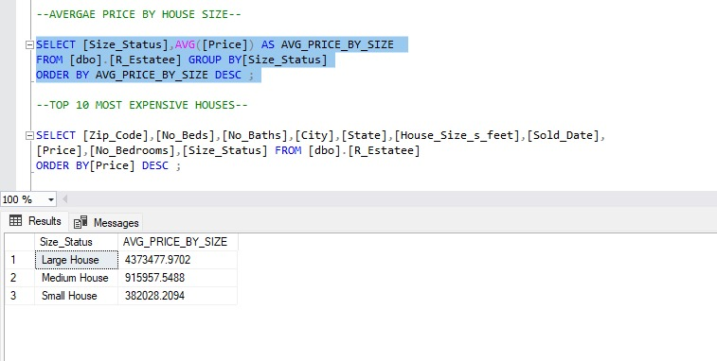
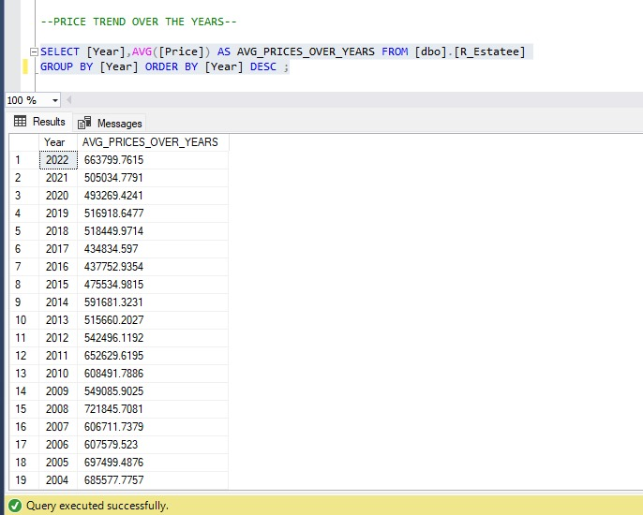
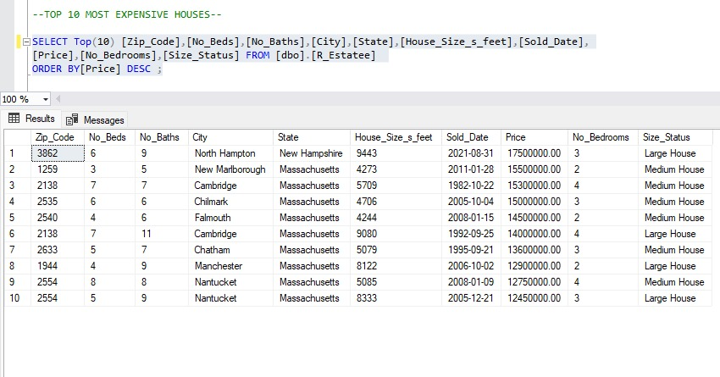

Slide 16
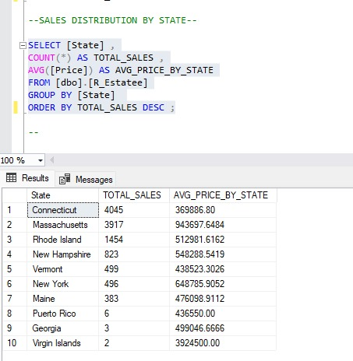
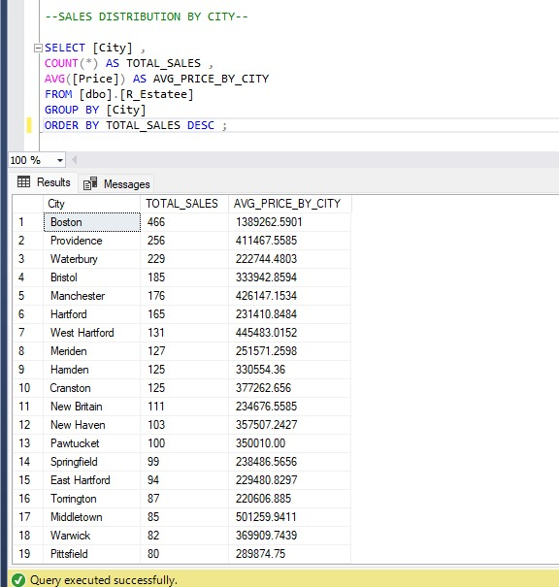

Slide 17
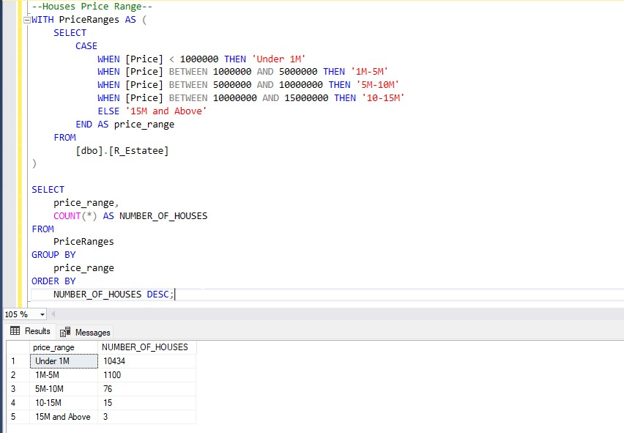

Slide 18
05
Data visualization

Slide 19
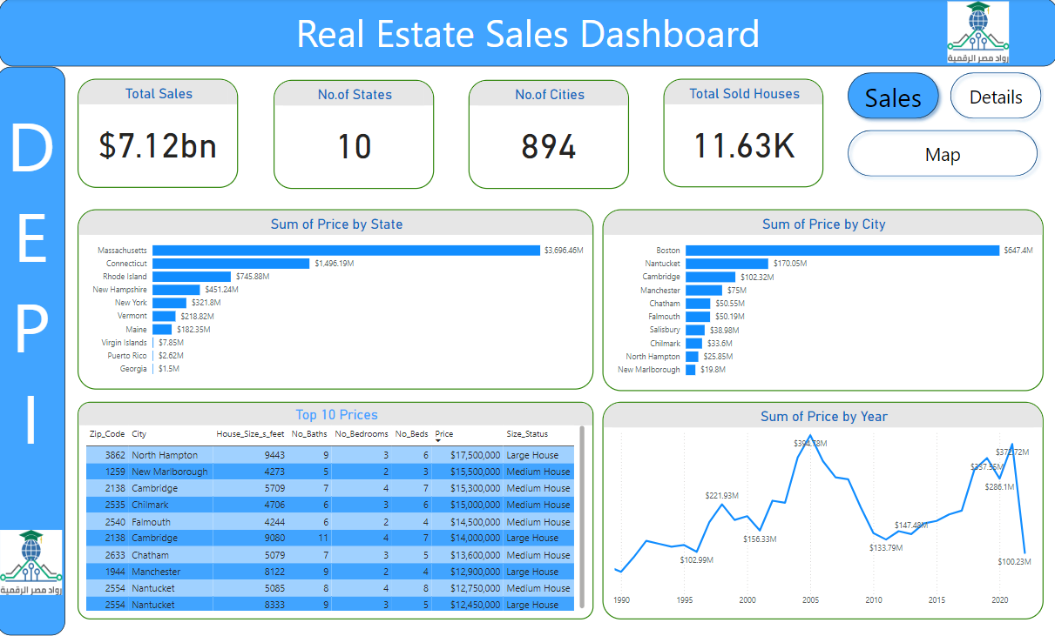

Slide 20
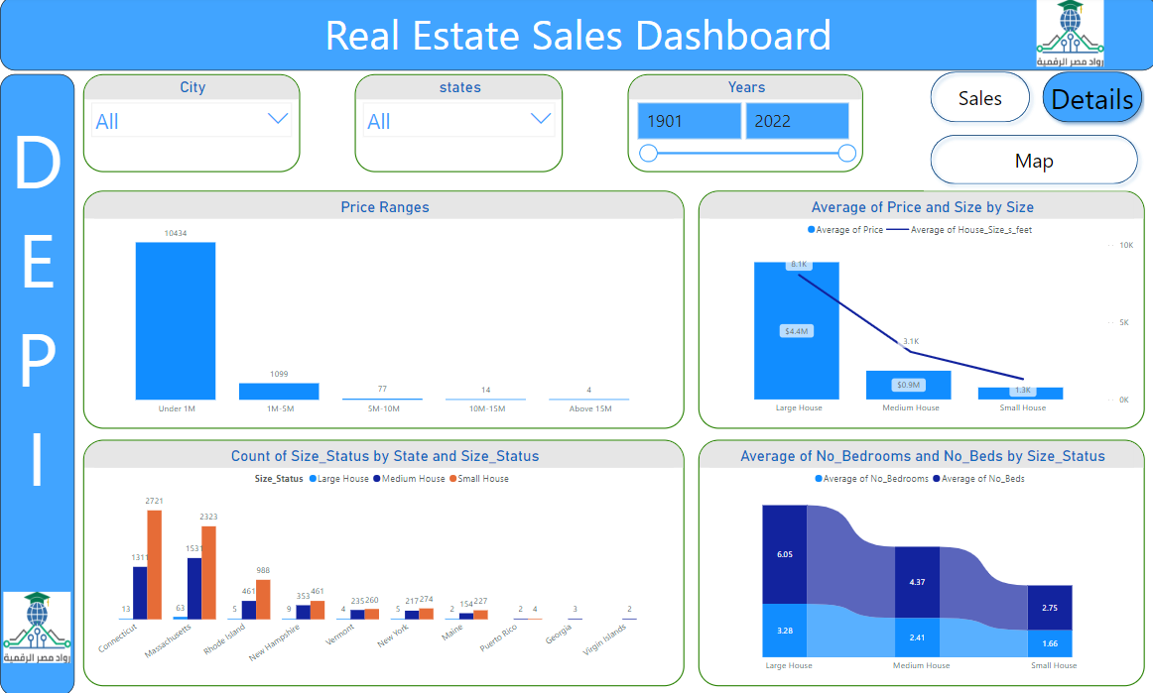

Slide 21
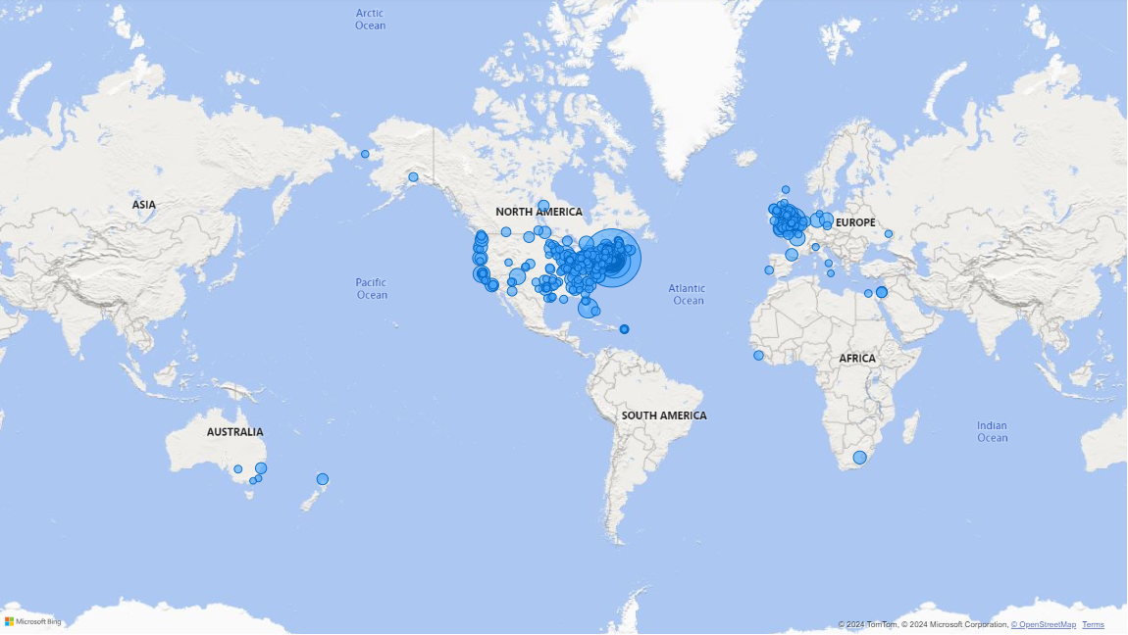

Slide 22








Tools and Technologies
Collect Data
Data Cleaning
Data Exploring
Data Exploring & Data Cleaning
Design Dashboard
Team Connections
Team meetings
Project GP
Presentation

Slide 23
Teamwork
 | Collecting Data | Data Cleaning | Data Exploring | Data visualization | Presentation
Mohamed Mohsen | 🗸 |  | 🗸 | 🗸
Mohamed fo’ad | 🗸 | 🗸 | 🗸
Abdelrahman Mohamed |  | 🗸 |  | 🗸 | 🗸
Zyad Mohamed | 🗸 | 🗸
Ahmed ElSayed |  |  | 🗸 | 🗸 | 🗸

Slide 24
Any Questions?

Slide 25


